Slide 1


this, super, final keywords in java
KVS CHARAN(T1735)
A Quest Global Company

Slide 2
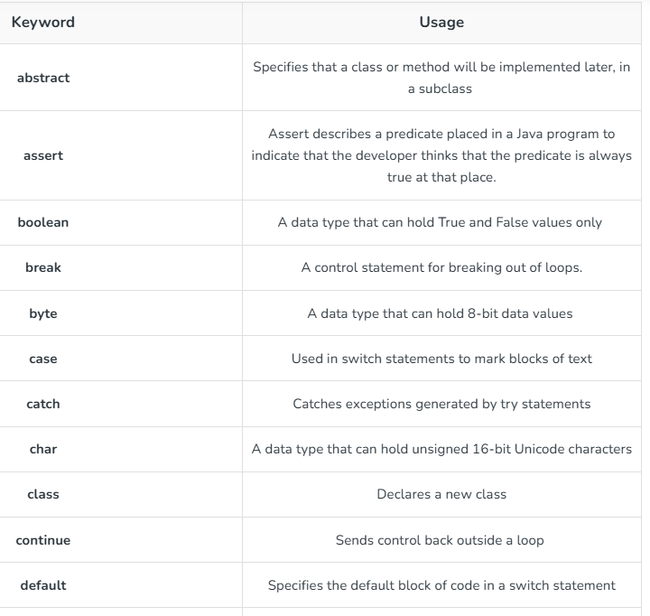

Slide 3
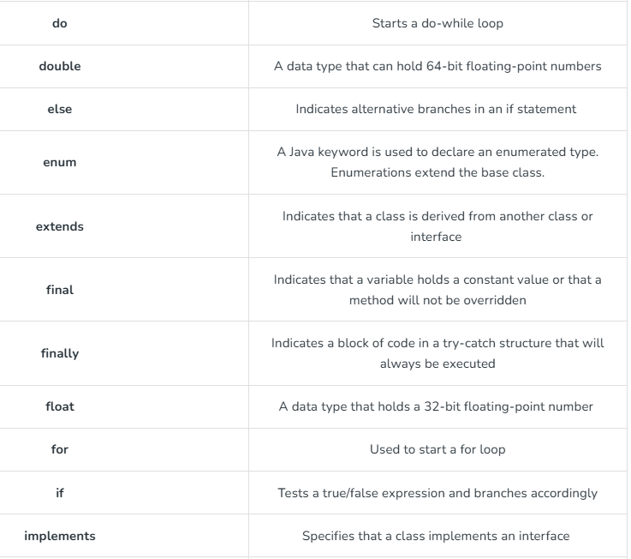

Slide 4
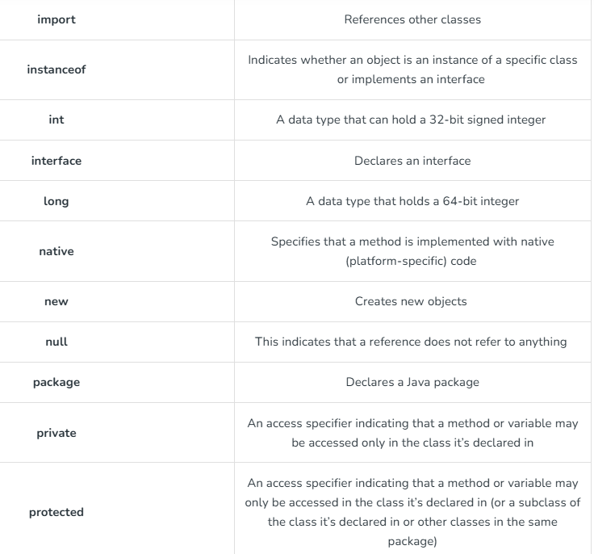

Slide 5
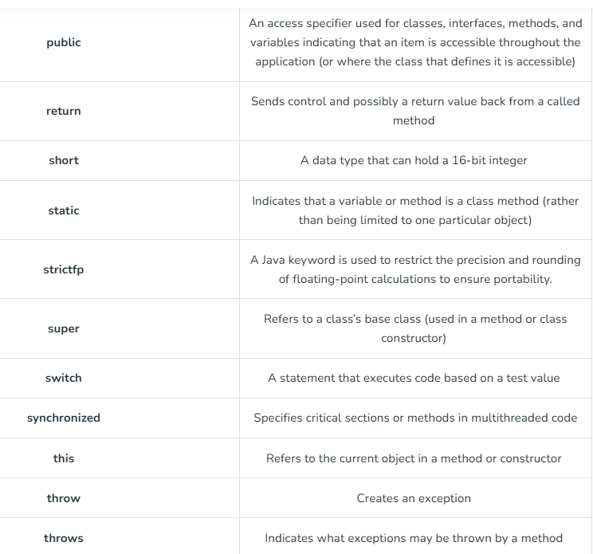

Slide 6
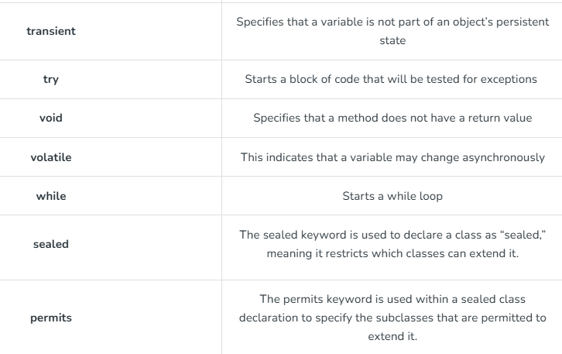

Slide 7
1: What is this keyword in java?
In Java, the this keyword refers to the current instance of a class.
It is often used to distinguish between instance variables and parameters with the same name, or to refer to the current object within methods or constructors.
Uses of ‘this’ keyword
Referencing Instance Variables: If a method or constructor has parameters with the same name as instance variables, the this keyword helps to refer to the instance variable.
Invoking Instance Methods: this can also be used to call an instance method within the class.
Invoking the Current Class Constructor: this() can be used to call another constructor in the same class. This is called constructor chaining.
Returning the Current Object: this can be used in methods to return the current object itself, which is useful for method chaining.
Distinguishing Between Local Variables and Instance Variables: In methods, this is helpful when local variables or parameters shadow instance variables.

Slide 8
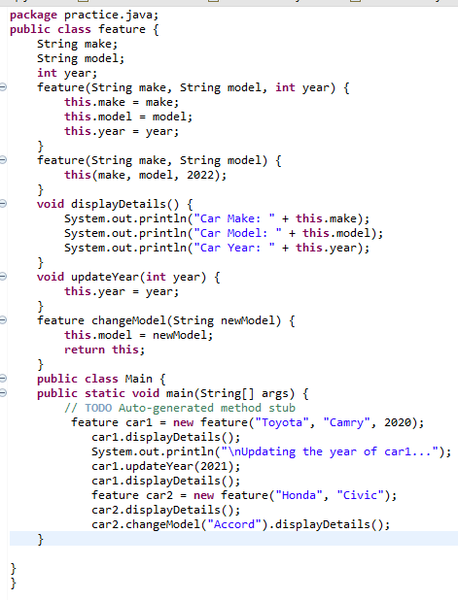
Car Make: Toyota
Car Model: Camry
Car Year: 2020
Updating the year of car1...
Car Make: Toyota
Car Model: Camry
Car Year: 2021
Car Make: Honda
Car Model: Civic
Car Year: 2022
Car Make: Honda
Car Model: Accord
Car Year: 2022
Output

Slide 9
this keyword (vs) super keyword
In Java, both the this and super keywords refer to the current object or its parent class, but they are used in different contexts and have distinct purposes.
this Keyword
The this keyword refers to the current instance of the class in which it is used.
Refer to the instance variables and methods of the current object.
Invoke the current class constructor (constructor chaining).
Return the current object from a method (method chaining).
super Keyword
The super keyword refers to the parent class (superclass) of the current object.
Access instance variables and methods of the parent class.
Call the constructor of the parent class.
Call overridden methods in the parent class.

Slide 10
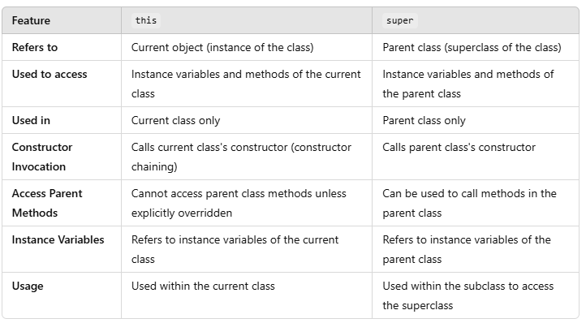
this (vs) super keyword

Slide 11
What is final keyword in java?
In Java, the final keyword is used to define constants, prevent method overriding, and prevent inheritance. It is a very important feature that helps in creating more secure, predictable, and optimized code.
Characteristics of final keyword in java
final with Variables
When the final keyword is applied to a variable, it means the variable cannot be reassigned after it is initialized. Once a final variable is assigned a value, that value cannot be changed.
final with Methods
When a method is declared as final, it cannot be overridden by any subclass. This is useful when you want to ensure that the method's behavior remains the same across all subclasses.
final with Classes
When a class is declared as final, it cannot be subclassed (i.e., no other class can inherit from it). This is useful for creating immutable or non-extendable classes.
final with Parameters
The final keyword can also be used with method parameters to ensure that their values cannot be changed inside the method.

Slide 12
final with Local Variables
Local variables inside methods can also be marked as final. Once assigned a value, they cannot be reassigned within the method.
final and Immutability
The final keyword is often used to create immutable objects. Immutable objects are objects whose state cannot be changed after they are created. This is particularly useful in concurrent programming or when you want to guarantee that the object's state remains consistent.
The final keyword is a powerful tool in Java that provides safety and stability in your code. It helps in creating constants, ensuring method behavior remains unmodified by subclasses, and preventing inheritance or reassignment, which is especially useful for designing secure and immutable objects.

Slide 13


